Slide 1

BookMySlot
WI-FI EVENT BOOKING SYSTEM
A centralized, web-based platform running on local campus networks to transform how colleges manage event registrations and seat bookings.
TEAM MEMBERS
Avani Biju
Akshaya A

Slide 2

The Problem
Current State
Most colleges currently use disconnected methods such as Google Forms, paper-based lists, and messaging applications to manage event registrations. Since these tools are not integrated into a single system, event data gets scattered across multiple platforms.
This leads to confusion among students, difficulty in tracking registrations, and manual errors such as duplicate entries and incorrect seat counts. Event organizers also face challenges in monitoring real-time participation and managing last-minute changes efficiently. As a result, the overall event registration process becomes time-consuming, inefficient, and unreliable.
Overbooking Issues
Poor Visibility
Data Fragmentation
No real-time seat tracking leads to exceeding capacity limits
Administrators can't monitor bookings effectively
Records scattered across multiple platforms without central database

Slide 3
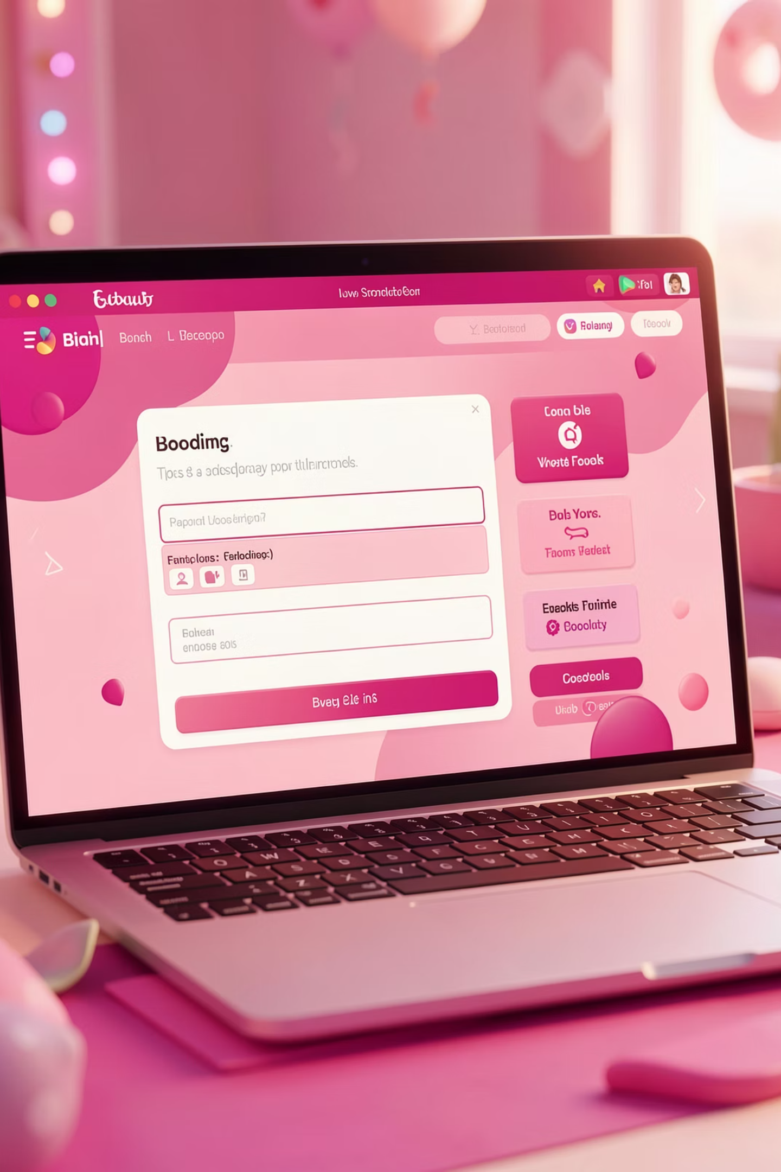
Project Goal & Vision
Build a simple, web-based event booking system that operates on campus Wi-Fi networks, allowing students to view events and reserve seats while giving administrators complete control through a unified platform.
This solution ensures accurate seat tracking, prevents overbooking, and maintains comprehensive booking records—all accessible within the campus network.

Slide 4
System Objectives
01
02
03
Simple User Interface
Seat Availability Tracking
Admin Dashboard
Intuitive interface for students to browse and book events seamlessly
Real-time seat counting prevents overbooking and double bookings
Complete control for administrators to create and manage all events
04
05
Centralized Database
Local Network Operation
Secure storage of all booking records and event information
Runs on same Wi-Fi network for campus-only access and demo purposes

Slide 5
Target Users & Scope
Users
Event Types
Designed for campus-wide events including college festivals, workshops, seminars, and club activities.
Administrators
Students
Create events
Manage Events
Set seat limits
Monitor bookings
View analytics
Log in securely
Browse events
Book seats
Track reservations
System operates within campus network boundaries and connects to Firebase for data storage—no external hosting required for demonstrations.

Slide 6





Technology Stack
Frontend
The frontend of the system is developed using HTML5, CSS3, and Vanilla JavaScript to create a responsive and interactive user interface for both admin and student dashboards.
Backend
The backend is implemented using Firebase Authentication for secure user login and Firebase Firestore as a serverless NoSQL database for real-time event and booking management.
Hosting
The application is hosted locally during development using Live Server in Visual Studio Code, and it can be deployed to Firebase Hosting for production use.
Tools
The development tools used include Visual Studio Code for coding, Firebase Console for backend configuration, and standard web browsers such as Google Chrome for testing and debugging.

Slide 7

System Architecture
Client Browser
HTML/JS running on campus Wi‑Fi
Realtime Database
Client-to-Firebase Data Flow
Frontend Pages
Writes and reads for events/bookings
UI components and event handlers
Firebase Backend
API Calls
Auth, Cloud Functions, and APIs
HTTPS requests to backend endpoints
All users connect through the same campus Wi-Fi network. The client browser accesses frontend pages built with HTML and JavaScript, which communicate with Firebase backend for authentication and data storage. Events and bookings are securely stored in the Firestore database, ensuring real-time synchronization across all users on the network.

Slide 8






Working Principle
User Authentication
Students and administrators log in using email and password credentials verified through Firebase Authentication
Role Detection
System automatically detects user role from database and redirects to appropriate interface
Admin Event Creation
Administrators enter event details including title, date, venue, and seat capacity which are stored in Firestore
Event Display
Students view real-time list of available events with current seat availability shown for each
Booking Process
Students select events and system checks seat availability before processing booking and reducing seat count
Admin Monitoring
Administrators access comprehensive panel to view all events, bookings, and system analytics

Slide 9
Database Design
1
2
3
Users Collection
Events Collection
Bookings Collection
email — User's email address
role — 'admin' or 'student' permission level
eventId — Unique event identifier
title — Event name
date — Scheduled date
venue — Location
seatsLeft — Available seats counter
bookingId — Unique booking reference
eventId — Associated event
userEmail — Student who booked
time-starting time
instructions-if wanted
image url- giving url id

Slide 10

Implementation Roadmap
Phase 1-2: Setup & Login
1
Create project structure, configure Firebase authentication, and build login system with role detection
2
Phase 3: Admin Module
Develop event creation form and implement data storage in Firestore database
Phase 4: Student Features
3
Build event display interface and implement seat booking functionality with availability checks
4
Phase 5: Integration
Connect frontend components to Firebase backend and thoroughly test complete booking workflow
Phase 6: Deployment
5
Run system on local laptop, access via Wi-Fi IP address, and validate campus network operation
Expected Outcome: Fully functional event booking system with real-time seat tracking, secure authentication, and comprehensive admin controls deployed on campus Wi-Fi.

Slide 11
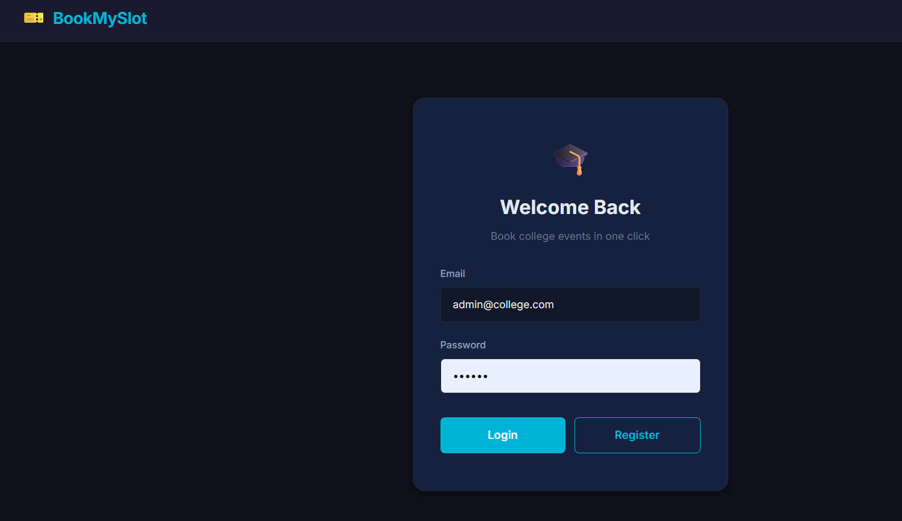
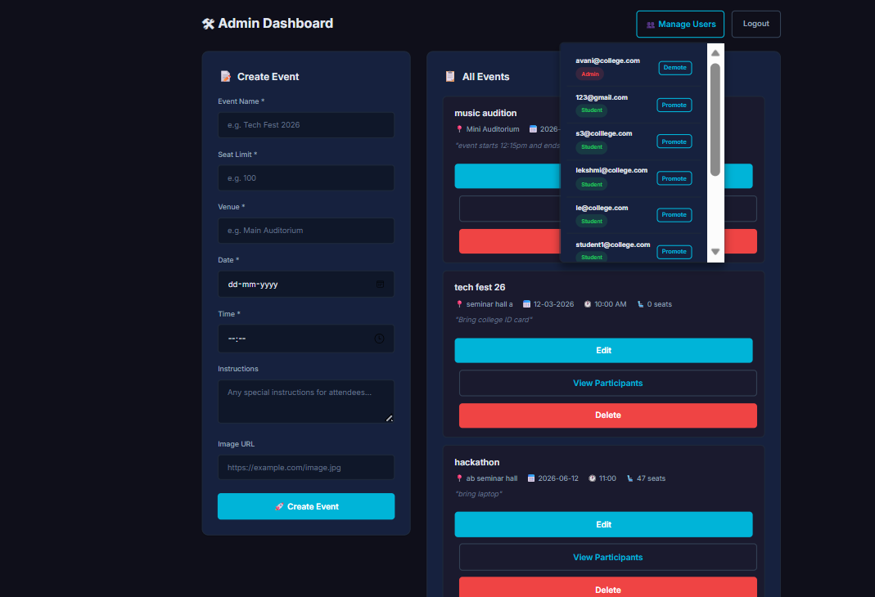
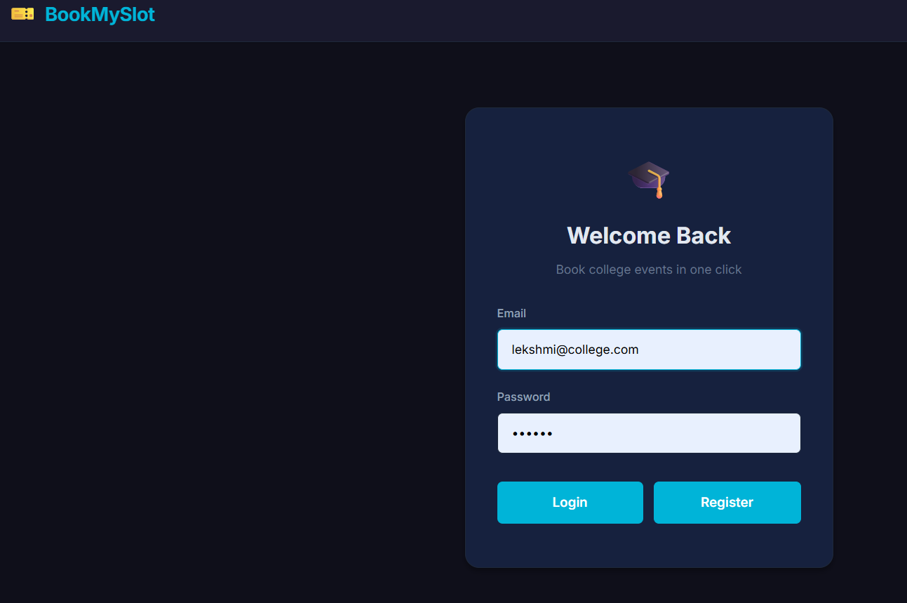
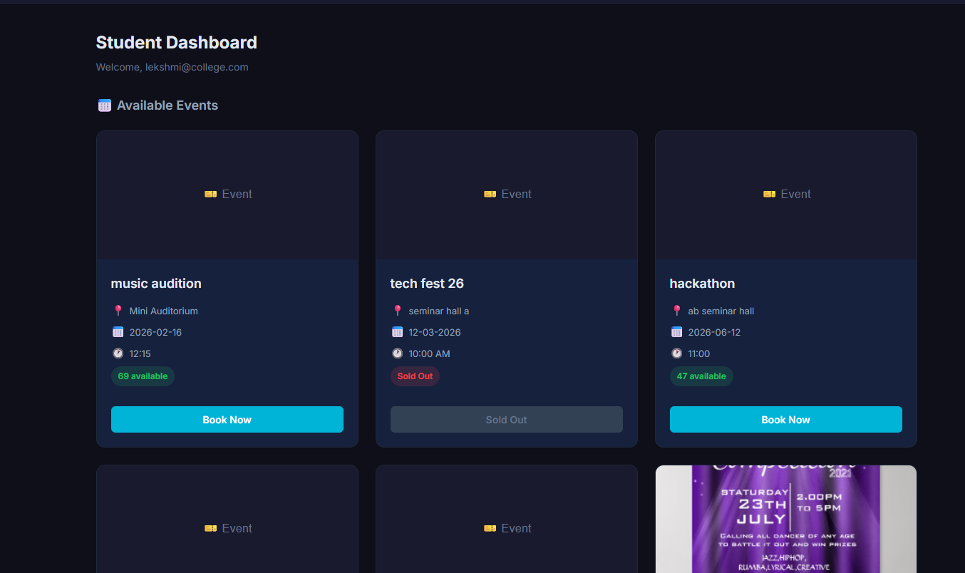
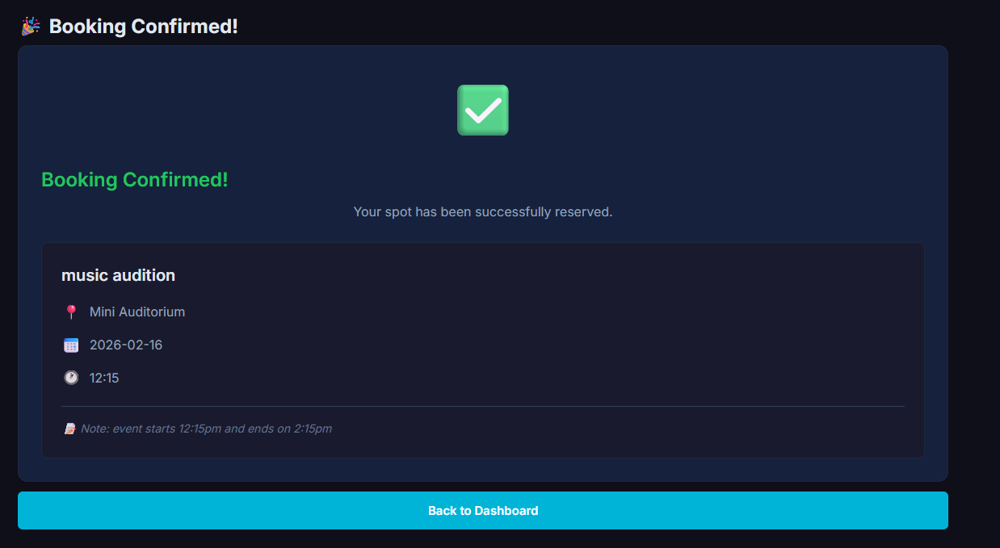
RESULT
Fig:1
Fig:2
Fig:3
Fig:4
Fig:5

Slide 12

CONCLUSION
The BookMySlot system provides an efficient and reliable solution for managing college event registrations by replacing scattered and manual methods with a centralized, digital platform. By using Firebase Authentication and Firestore, the system ensures secure access, real-time updates, and accurate seat management. This reduces confusion, prevents overbooking, and saves time for both students and event organizers. Overall, the system improves the event registration process by making it faster, more organized, and user-friendly.

Slide 13
THANK YOU

